Slide 2
1. Gerando uma Janela

Slide 3
public class Program {
private static void Main(string[] args) {
Console.WriteLine("Hello, World!");
}
}

Slide 4
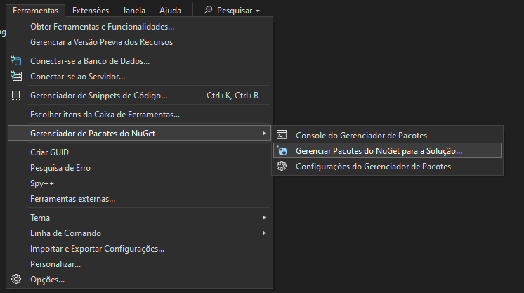
Instalando a partir do NuGet

Slide 5
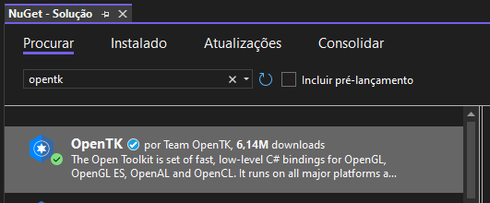

Slide 6
using OpenTK.Windowing.Desktop;
namespace SeuNamespaceAqui; public class Program : GameWindow { private Program(GameWindowSettings gws, NativeWindowSettings nws) : base(gws, nws) {
CenterWindow();
}
private static void Main(string[] args) {
GameWindowSettings gws = GameWindowSettings.Default;
NativeWindowSettings nws = NativeWindowSettings.Default;
nws.ClientSize = (1024, 768);
nws.Title = "Game";
new Program(gws, nws).Run();
}
}

Slide 7


Slide 8
using OpenTK.Windowing.Common;
using OpenTK.Windowing.Desktop;
namespace SeuNamespaceAqui; public class Program : GameWindow { [...]
protected override void OnRenderFrame(FrameEventArgs args) {
SwapBuffers();
}
}

Slide 9
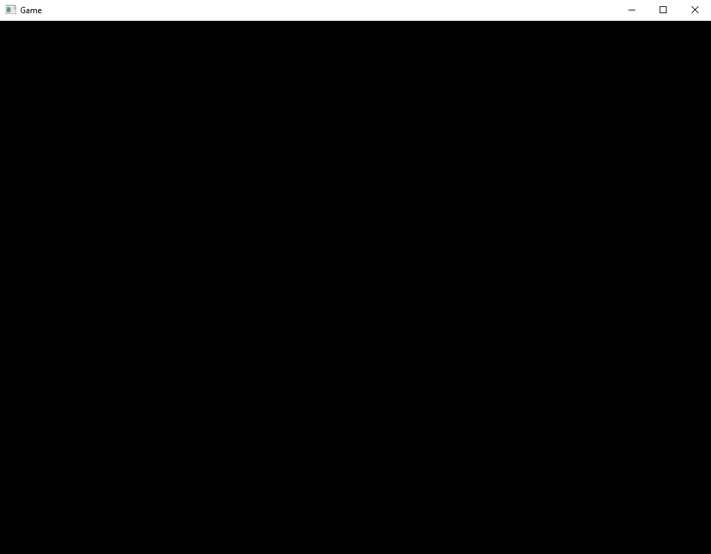

Slide 10
using OpenTK.Graphics.OpenGL4;
using OpenTK.Windowing.Common;
using OpenTK.Windowing.Desktop;
namespace SeuNamespaceAqui; public class Program : GameWindow { [...]
protected override void OnRenderFrame(FrameEventArgs args) {
GL.ClearColor(0.5f, 0.8f, 1.0f, 0.0f);
GL.Clear(ClearBufferMask.ColorBufferBit);
SwapBuffers();
}
}

Slide 11


Slide 12
using OpenTK.Graphics.OpenGL4;
using OpenTK.Windowing.Common;
using OpenTK.Windowing.Desktop;
namespace SeuNamespaceAqui; public class Program : GameWindow {
private Program(GameWindowSettings gws, NativeWindowSettings nws) : base(gws, nws) {
CenterWindow();
}
[...]
protected override void OnFramebufferResize(FramebufferResizeEventArgs e) {
this.width = e.Width;
this.height = e.Height;
GL.Viewport(0, 0, e.Width, e.Height);
}
[...]
}

Slide 13
using OpenTK.Graphics.OpenGL4;
using OpenTK.Windowing.Common;
using OpenTK.Windowing.Desktop;
using OpenTK.Windowing.GraphicsLibraryFramework;
namespace SeuNamespaceAqui; public class Program : GameWindow { [...]
protected override void OnRenderFrame(FrameEventArgs args) {
processInput();
GL.ClearColor(0.5f, 0.8f, 1.0f, 0.0f);
GL.Clear(ClearBufferMask.ColorBufferBit);
SwapBuffers();
}
public void processInput() {
if(KeyboardState.IsKeyDown(Keys.Escape)) {
Close();
}
}
}

Slide 15
2. Gerando um Triangulo

Slide 16
#version 330 core
layout (location = 0) in vec3 aPos;
void main() {
gl_Position = vec4(aPos, 1.0);
}

Slide 17
#version 330 core
out vec4 FragColor;
void main() {
FragColor = vec4(1.0f, 0.5f, 0.2f, 1.0f);
}

Slide 18
using OpenTK.Graphics.OpenGL4;
namespace SeuNamespaceAqui; public class Shader {
public int shaderProgram;
public Shader(string vertexPath, string fragmentPath) {
[...]
}
}

Slide 19
int success;
string infoLog;
string vertexShaderSource = File.ReadAllText("../../../src/shaders/" + vertexPath);
string fragmentShaderSource = File.ReadAllText("../../../src/shaders/" + fragmentPath);

Slide 20
// sombreador de vértice
int vertexShader = GL.CreateShader(ShaderType.VertexShader);
GL.ShaderSource(vertexShader, vertexShaderSource);
GL.CompileShader(vertexShader);
// verifique se há erros de compilação do shader
GL.GetShader(vertexShader, ShaderParameter.CompileStatus, out success);
if(success == 0) {
GL.GetShaderInfoLog(vertexShader, out infoLog);
Console.WriteLine("ERROR::SHADER::VERTEX::COMPILATION_FAILED\n" + infoLog);
}

Slide 21
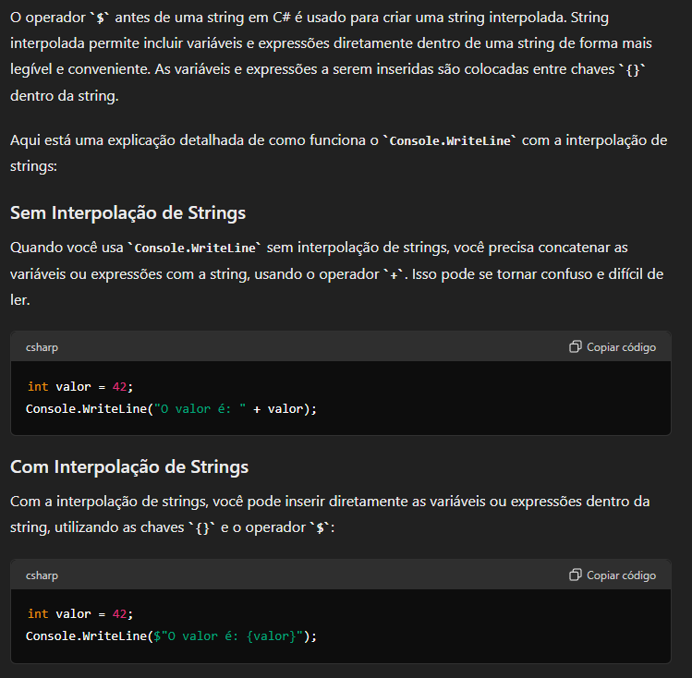

Slide 22
// sombreador de fragmento
int fragmentShader = GL.CreateShader(ShaderType.FragmentShader);
GL.ShaderSource(fragmentShader, fragmentShaderSource);
GL.CompileShader(fragmentShader);
// verifique se há erros de compilação do shader
GL.GetShader(fragmentShader, ShaderParameter.CompileStatus, out success);
if(success == 0) {
GL.GetShaderInfoLog(fragmentShader, out infoLog);
Console.WriteLine("ERROR::SHADER::FRAGMENT::COMPILATION_FAILED\n" + infoLog);
}

Slide 23
// shaders de link
shaderProgram = GL.CreateProgram();
GL.AttachShader(shaderProgram, vertexShader);
GL.AttachShader(shaderProgram, fragmentShader);
GL.LinkProgram(shaderProgram);
// verifique se há erros de compilação do shader
GL.GetProgram(shaderProgram, GetProgramParameterName.LinkStatus, out success);
if(success == 0) {
GL.GetShaderInfoLog(shaderProgram, out infoLog);
Console.WriteLine("ERROR::SHADER::PROGRAM::LINKING_FAILED\n" + infoLog);
}

Slide 24
GL.DeleteShader(vertexShader);
GL.DeleteShader(fragmentShader);

Slide 25
using OpenTK.Graphics.OpenGL4;
namespace SeuNamespaceAqui; public class Shader {
public int shaderProgram;
public Shader(string vertexPath, string fragmentPath) {
[...]
}
public void use() {
GL.UseProgram(this.shaderProgram);
}
}

Slide 26
using OpenTK.Graphics.OpenGL4;
using OpenTK.Windowing.Common;
using OpenTK.Windowing.Desktop;
using OpenTK.Windowing.GraphicsLibraryFramework;
namespace SeuNamespaceAqui; public class Program : GameWindow {
private Shader shader;
[...]
protected override void OnLoad() {
shader = new Shader(“shader.vert”, “shader.frag”);
}
protected override void OnRenderFrame(FrameEventArgs args) {
shader.use();
}
[...]
}

Slide 28
using OpenTK.Graphics.OpenGL4;
namespace SeuNamespaceAqui; public class Tesselator {
}

Slide 29
+Y
0.0f, 0.5f
2
0
1
+X
-0.5f, -0.5f
0.5f, -0.5f
-0.5f, -0.5f
0.5f, -0.5f
0.0f, 0.5f

Slide 30
private float[] vertices = {
-0.5f, -0.5f, // Bottom-left vertex
0.5f, -0.5f, // Bottom-right vertex
0.0f, 0.5f // Top vertex
};
private int VAO; // Vertex Array Object
private int VBO; // Vertex Buffer Object

Slide 31
public Tesselator() {
GL.GenVertexArrays(1, out VAO);
GL.GenBuffers(1, out VBO);
GL.BindVertexArray(VAO);
GL.BindBuffer(BufferTarget.ArrayBuffer, VBO);
GL.BufferData(BufferTarget.ArrayBuffer, vertices.Length * sizeof(float), vertices, BufferUsageHint.StaticDraw);
GL.VertexAttribPointer(0, 2, VertexAttribPointerType.Float, false, 0, 0);
GL.EnableVertexAttribArray(0);
GL.BindBuffer(BufferTarget.ArrayBuffer, 0);
GL.BindVertexArray(0);
}

Slide 32
public void bind() {
GL.BindVertexArray(VAO);
GL.DrawArrays(PrimitiveType.Triangles, 0, 3);
}

Slide 33
using OpenTK.Graphics.OpenGL4;
using OpenTK.Windowing.Common;
using OpenTK.Windowing.Desktop;
using OpenTK.Windowing.GraphicsLibraryFramework;
namespace SeuNamespaceAqui; public class Program : GameWindow {
private Shader shader;
private Tesseletor t;
[...]
protected override void OnLoad() {
shader = new Shader(“shader.vert”, “shader.frag”);
t = new Tesselator();
}
protected override void OnRenderFrame(FrameEventArgs args) {
shader.use();
t.bind();
}
[...]
}

Slide 34
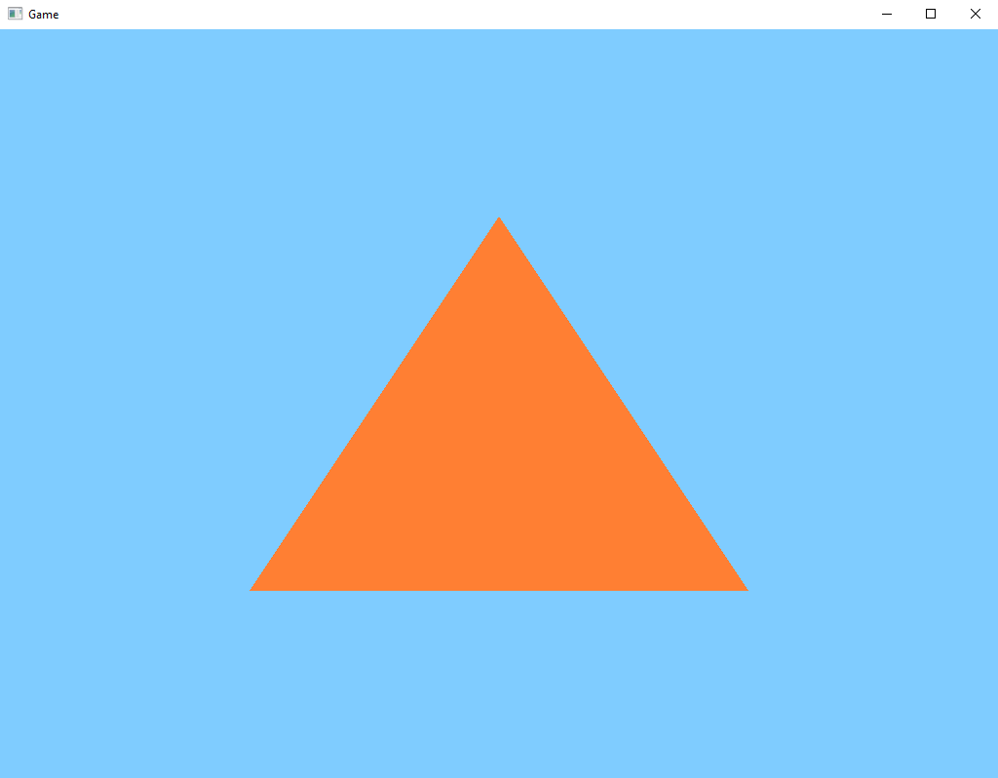

Slide 35
+Y
0.0f, 1.0f
0.0f, 0.5f
-1.0f, 0.0f
1.0f, 0.0f
-0.5f, -0.5f
0.5f, -0.5f
+X
0.0f, -1.0f

Slide 37
3. Gerando um Retângulo

Slide 38
3
2
0
1
0, 1, 2
0, 2, 3

Slide 39
using OpenTK.Graphics.OpenGL4;
namespace SeuNamespaceAqui; public class Tesselator {
[...]
private int[] indices = {
0, 1, 3, // primeiro Triângulo
1, 2, 3 // segundo Triângulo
};
[...]
private int EBO; // Element Buffer Object
[...]
}

Slide 40
public Tesselator() {
[...]
GL.GenBuffers(1, out EBO);
[...]
GL.BindBuffer(BufferTarget.ElementArrayBuffer, EBO);
GL.BufferData(BufferTarget.ElementArrayBuffer, indices.Length * sizeof(int), indices, BufferUsageHint.StaticDraw);
[...]
}

Slide 41
public void bind() {
GL.BindVertexArray(VAO);
GL.DrawElements(PrimitiveType.Triangles, 6, DrawElementsType.UnsignedInt, 0);
}

Slide 42
+Y
-0.5f, 0.5f
0.5f, 0.5f
3
2
0
1
+X
-0.5f, -0.5f
0.5f, -0.5f
-0.5f, -0.5f
0.5f, -0.5f
0.5f, 0.5f
-0.5f, 0.5f

Slide 43
using OpenTK.Graphics.OpenGL4;
namespace SeuNamespaceAqui; public class Tesselator {
private float[] vertices = {
-0.5f, -0.5f, // bottom left
0.5f, -0.5f, // bottom right
0.5f, 0.5f, // top right
-0.5f, 0.5f // top left
};
[...]
}

Slide 44
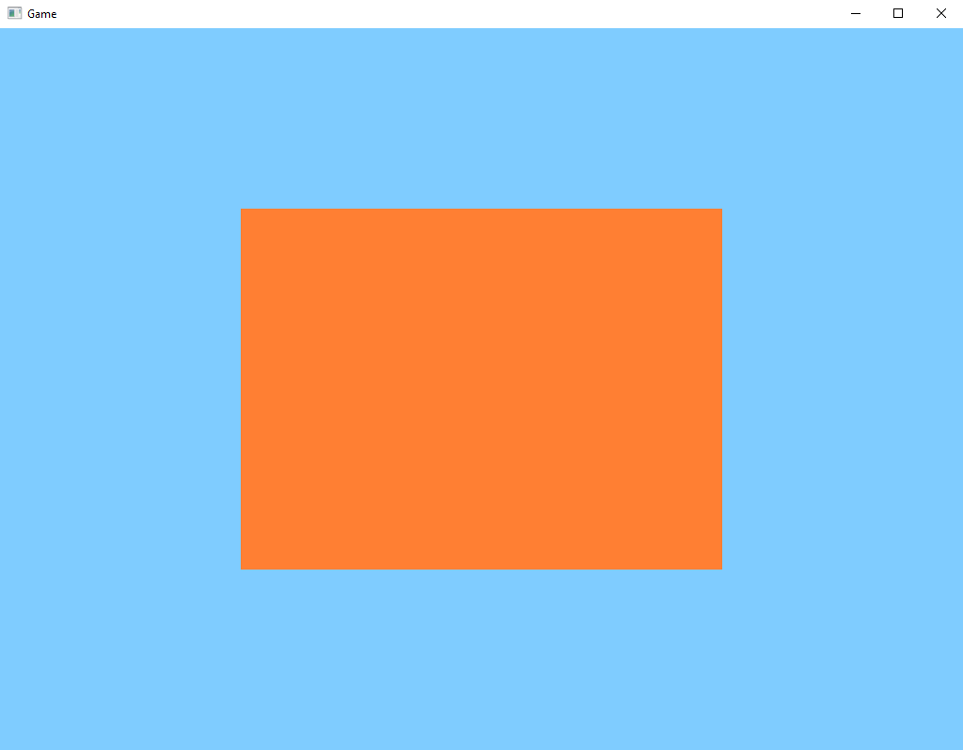

Slide 45
+Y
0.0f, 1.0f
-0.5f, 0.5f
0.5f, 0.5f
-1.0f, 0.0f
1.0f, 0.0f
-0.5f, -0.5f
0.5f, -0.5f
+X
0.0f, -1.0f

Slide 46
float x0 = -0.5f;
float y0 = -0.5f;
float x1 = 0.5f;
float y1 = 0.5f;
+Y
x0, y1
x1, y1
3
2
0
1
+X
x0, y0
x1, y0
x0, y0
x1, y0
x1, y1
x0, y1

Slide 47
using OpenTK.Graphics.OpenGL4;
namespace SeuNamespaceAqui; public class Tesselator {
private float[] vertices = new float[300000];
[...]
private void vertex() {
vertices[0] = -0.5f; // bottom left - x
vertices[1] = -0.5f; // bottom left - y
vertices[2] = 0.5f; // bottom right - x
vertices[3] = -0.5f; // bottom right - y
vertices[4] = 0.5f; // top right - x
vertices[5] = 0.5f; // top right - y
vertices[6] = -0.5f; // top left - x
vertices[7] = 0.5f; // top left - y
}
}

Slide 48
private float[] vertices = new float[300000];
[...]
private void vertex() {
float x0 = -0.5f;
float x1 = 0.5f;
float y0 = -0.5f;
float y1 = 0.5f;
vertices[0] = x0; // bottom left - x
vertices[1] = y0; // bottom left - y
vertices[2] = x1; // bottom right - x
vertices[3] = y0; // bottom right - y
vertices[4] = x1; // top right - x
vertices[5] = y1; // top right - y
vertices[6] = x0; // top left - x
vertices[7] = y1; // top left - y
}

Slide 49
using OpenTK.Graphics.OpenGL4;
using OpenTK.Mathematics;
namespace SeuNamespaceAqui; public class Tesselator {
private Vector2[] vertices = new Vector2[300000];
[...]
private void vertex() {
float x0 = -0.5f;
float x1 = 0.5f;
float y0 = -0.5f;
float y1 = 0.5f;
vertices[0] = new Vector2(x0, y0);
vertices[1] = new Vector2(x1, y0);
vertices[2] = new Vector2(x1, y1);
vertices[3] = new Vector2(x0, y1);
}
}

Slide 50
private List<Vector2> vertices = new List<Vector2>();
private Tesselator() {
[...]
GL.BufferData(BufferTarget.ArrayBuffer, vertices.Count * Vector2.SizeInBytes, vertices.ToArray(), BufferUsageHint.StaticDraw);
[...]
}
[...]
private void vertex() {
float x0 = -0.5f;
float x1 = 0.5f;
float y0 = -0.5f;
float y1 = 0.5f;
vertices.Add(new Vector2(x0, y0));
vertices.Add(new Vector2(x1, y0));
vertices.Add(new Vector2(x1, y1));
vertices.Add(new Vector2(x0, y1));
}

Slide 51
private float[] vertices = new float[300000];
private int vertices_indices = 0;
private Tesselator() {
float x0 = -0.5f;
float x1 = 0.5f;
float y0 = -0.5f;
float y1 = 0.5f;
this.vertex(x0, y0); // bottom left
this.vertex(x1, y0); // bottom right
this.vertex(x1, y1); // top right
this.vertex(x0, y1); // top left
[...]
}
[...]
private void vertex(int x, int y) {
vertices[vertices_indices * 2 + 0] = x;
vertices[vertices_indices * 2 + 1] = y;
vertices_indices++;
}

Slide 52
float x0 = 0.0f;
float x1 = 1.0f;
float y0 = 0.0f;
float y1 = 1.0f;
+Y
x0, y1
x1, y1
3
2
0
1
+X
x0, y0
x1, y0
x0, y0
x1, y0
x1, y1
x0, y1

Slide 53
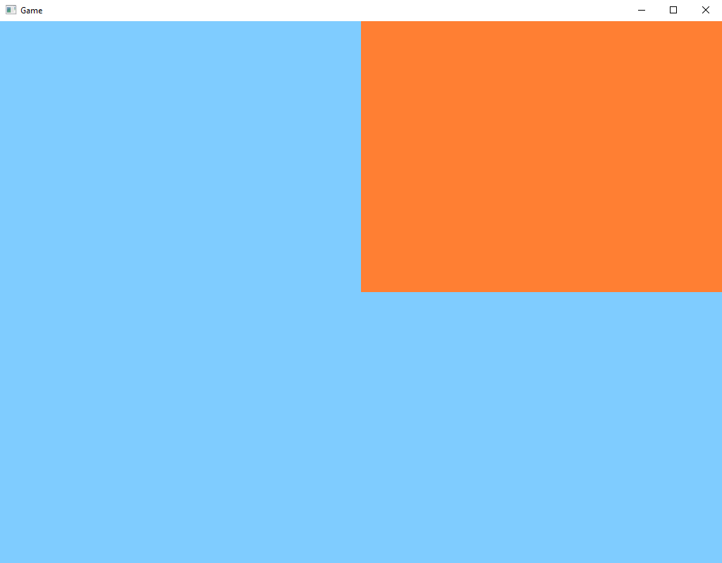
+Y
0.0f, 1.0f
1.0f, 1.0f
-1.0f, 0.0f
1.0f, 0.0f
0.0f, 0.0f
+X
0.0f, -1.0f

Slide 56
4. Wireframe

Slide 57
private bool isWireframe = false;
private void processInput() {
[...]
if(KeyboardState.IsKeyDown(Keys.F3) && KeyboardState.IsKeyPressed(Keys.W)) {
isWireframe = !isWireframe;
GL.PolygonMode(MaterialFace.FrontAndBack, isWireframe ? PolygonMode.Line : PolygonMode.Fill);
}
}

Slide 58
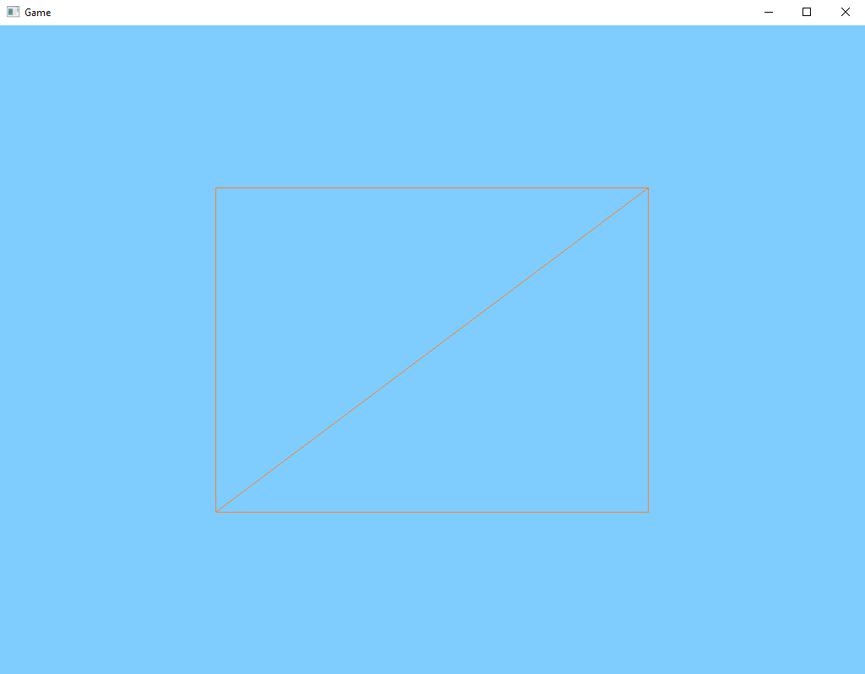

Slide 59
#version 330 core
out vec4 FragColor;
uniform bool isWireframe;
void main() {
if(!isWireframe) {
// define a cor padrão do nosso retangulo
FragColor = vec4(1.0f, 0.5f, 0.2f, 1.0f);
}
else {
// define uma cor preta para o wireframe
FragColor = vec4(0.0f);
}
}

Slide 60
private bool isWireframe = false;
private void processInput() {
[...]
if(KeyboardState.IsKeyDown(Keys.F3) && KeyboardState.IsKeyPressed(Keys.W)) {
isWireframe = !isWireframe;
GL.Uniform1(GL.GetUniformLocation(shader.shaderProgram, "isWireframe"), isWireframe ? 1 : 0);
GL.PolygonMode(MaterialFace.FrontAndBack, isWireframe ? PolygonMode.Line : PolygonMode.Fill);
}
}

Slide 61
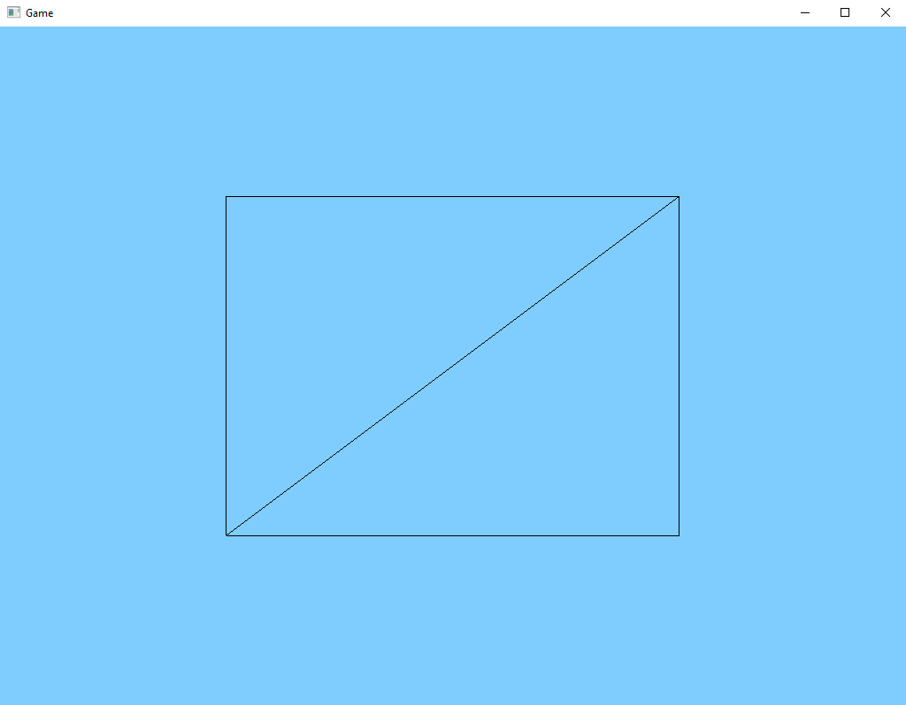

Slide 62
public class Shader() {
[...]
public void setBool(string name, bool value) {
GL.Uniform1(GL.GetUniformLocation(shaderProgram, name), value ? 1 : 0);
}
}

Slide 63
private bool isWireframe = false;
private void processInput() {
[...]
if(KeyboardState.IsKeyDown(Keys.F3) && KeyboardState.IsKeyPressed(Keys.W)) {
isWireframe = !isWireframe;
shader.setBool(“isWireframe”, isWireframe);
GL.PolygonMode(MaterialFace.FrontAndBack, isWireframe ? PolygonMode.Line : PolygonMode.Fill);
}
}

Slide 65
5. Gerando uma Textura

Slide 66


Slide 67
#version 330 core
layout (location = 0) in vec3 aPos;
layout(location = 1) in vec2 aTexCoord;
out vec2 TexCoord;
void main() {
gl_Position = vec4(aPos, 1.0);
TexCoord = aTexCoord;
}

Slide 68
#version 330 core
out vec4 FragColor;
uniform bool isWireframe;
in vec2 TexCoord;
uniform sampler2D texture0;
void main() {
if(isWireframe) {
FragColor = vec4(0.0f);
}
else {
FragColor = texture(texture0, TexCoord);
}
}

Slide 69
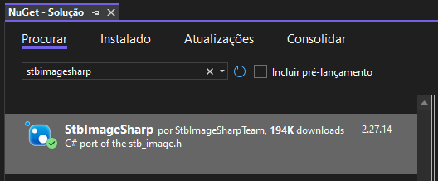

Slide 70
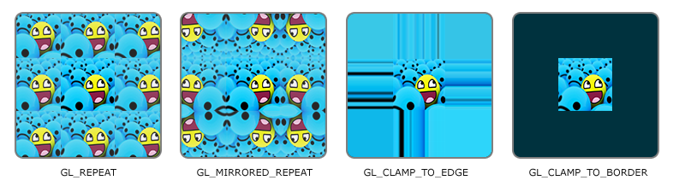

Slide 71
GL.TexParameter(TextureTarget.Texture2D, TextureParameterName.TextureWrapS, (int)TextureWrapMode.Repeat);
GL.TexParameter(TextureTarget.Texture2D, TextureParameterName.TextureWrapT, (int)TextureWrapMode.Repeat);

Slide 72


Slide 73
GL.TexParameter(TextureTarget.Texture2D, TextureParameterName.TextureMinFilter, (int)TextureMinFilter.Nearest);
GL.TexParameter(TextureTarget.Texture2D, TextureParameterName.TextureMagFilter, (int)TextureMagFilter.Nearest);

Slide 74
using OpenTK.Graphics.OpenGL4;
using StbImageSharp;
public class Texture() {
public int texture;
public Texture(string texturePath) {
GL.GenTextures(1, out texture);
GL.BindTexture(TextureTarget.Texture2D, texture);
GL.TexParameter(TextureTarget.Texture2D, TextureParameterName.TextureWrapS, (int)TextureWrapMode.Repeat);
GL.TexParameter(TextureTarget.Texture2D, TextureParameterName.TextureWrapT, (int)TextureWrapMode.Repeat);
GL.TexParameter(TextureTarget.Texture2D, TextureParameterName.TextureMinFilter, (int)TextureMinFilter.Nearest);
GL.TexParameter(TextureTarget.Texture2D, TextureParameterName.TextureMagFilter, (int)TextureMagFilter.Nearest);
//StbImage.stbi_set_flip_vertically_on_load(1);
ImageResult image = ImageResult.FromStream(File.OpenRead("../../../src/textures/" + texturePath), ColorComponents.RedGreenBlueAlpha);
if(image.Data != null) {
GL.TexImage2D(TextureTarget.Texture2D, 0, PixelInternalFormat.Rgba, image.Width, image.Height, 0, PixelFormat.Rgba, PixelType.UnsignedByte, image.Data);
GL.GenerateMipmap(GenerateMipmapTarget.Texture2D);
}
else {
Console.WriteLine("Failed to load texture");
}
}
public void bind() {
GL.BindTexture(TextureTarget.Texture2D, texture);
}
}

Slide 75
using OpenTK.Graphics.OpenGL4;
using OpenTK.Windowing.Common;
using OpenTK.Windowing.Desktop;
using OpenTK.Windowing.GraphicsLibraryFramework;
namespace SeuNamespaceAqui; public class Program : GameWindow {
[...]
private Texture texture;
[...]
protected override void OnLoad() {
[...]
texture = new Texture();
}
protected override void OnRenderFrame(FrameEventArgs args) {
[...]
texture.bind();
}
[...]
}

Slide 76
+V
0.0f, 1.0f
1.0f, 1.0f
3
2
0
1
+U
0.0f, 0.0f
1.0f, 0.0f
0.0f, 0.0f
1.0f, 0.0f
1.0f, 1.0f
0.0f, 1.0f

Slide 77
private float[] vertexBuffer = new float[300000];
private int vertices = 0;
private Tesselator() {
float x0 = -0.5f;
float x1 = 0.5f;
float y0 = -0.5f;
float y1 = 0.5f;
this.vertex(x0, y0); // bottom left
this.vertex(x1, y0); // bottom right
this.vertex(x1, y1); // top right
this.vertex(x0, y1); // top left
[...]
}
[...]
private void vertex(int x, int y) {
vertexBuffer[vertices * 2 + 0] = x;
vertexBuffer[vertices * 2 + 1] = y;
vertices++;
}

Slide 78
private float[] texCoordBuffer = new float[200000];
private int TBO; // Texture Buffer Object
public void flush() {
[...]
GL.GenBuffers(1, out this.TBO);
GL.BindBuffer(BufferTarget.ArrayBuffer, this.TBO);
GL.BufferData(BufferTarget.ArrayBuffer, this.texCoordBuffer.Length * sizeof(float), this.texCoordBuffer, BufferUsageHint.StaticDraw);
GL.VertexAttribPointer(1, 2, VertexAttribPointerType.Float, false, 0, 0);
GL.EnableVertexAttribArray(1);
[...]
}
private void tex(float u, float v) {
this.texCoordBuffer[this.vertices * 2 + 0] = u;
this.texCoordBuffer[this.vertices * 2 + 1] = v;
}

Slide 79
private float[] vertexBuffer = new float[300000];
private int vertices = 0;
private Tesselator() {
float x0 = -0.5f;
float x1 = 0.5f;
float y0 = -0.5f;
float y1 = 0.5f;
float u0 = 0.0f;
float v0 = 0.0f;
float u1 = 1.0f;
float v1 = 1.0f;
this.tex(u0, v0);
this.vertex(x0, y0); // bottom left
this.tex(u1, v0);
this.vertex(x1, y0); // bottom right
this.tex(u1, v1);
this.vertex(x1, y1); // top right
this.tex(u0, v1);
this.vertex(x0, y1); // top left
[...]
}
[...]
private void vertex(int x, int y) {
[...]
}
public void tex(float u, float v) {
[...]
}

Slide 80
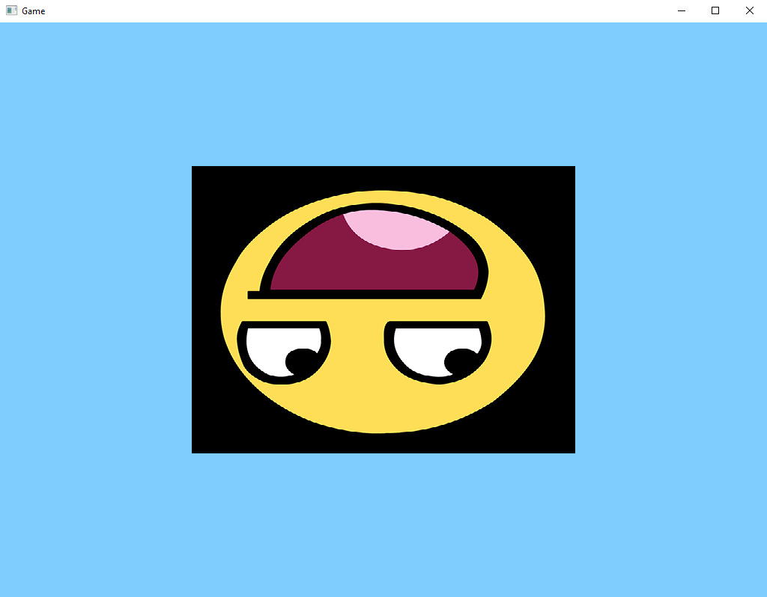

Slide 81
Então acrescentamos essa linha..
StbImage.stbi_set_flip_vertically_on_load(1);

Slide 82
using OpenTK.Graphics.OpenGL4;
using StbImageSharp;
public class Texture() {
public int texture;
public Texture(string texturePath) {
GL.GenTextures(1, out texture);
GL.BindTexture(TextureTarget.Texture2D, texture);
GL_TEXTURE_2D agora terão efeito neste objeto de textura
GL.TexParameter(TextureTarget.Texture2D, TextureParameterName.TextureWrapS, (int)TextureWrapMode.Repeat);
GL.TexParameter(TextureTarget.Texture2D, TextureParameterName.TextureWrapT, (int)TextureWrapMode.Repeat);
GL.TexParameter(TextureTarget.Texture2D, TextureParameterName.TextureMinFilter, (int)TextureMinFilter.Nearest);
GL.TexParameter(TextureTarget.Texture2D, TextureParameterName.TextureMagFilter, (int)TextureMagFilter.Nearest);
StbImage.stbi_set_flip_vertically_on_load(1);
ImageResult image = ImageResult.FromStream(File.OpenRead("../../../src/textures/" + texturePath), ColorComponents.RedGreenBlueAlpha);
if(image.Data != null) {
GL.TexImage2D(TextureTarget.Texture2D, 0, PixelInternalFormat.Rgba, image.Width, image.Height, 0, PixelFormat.Rgba, PixelType.UnsignedByte, image.Data);
GL.GenerateMipmap(GenerateMipmapTarget.Texture2D);
}
else {
Console.WriteLine("Failed to load texture");
}
}
public void bind() {
GL.BindTexture(TextureTarget.Texture2D, texture);
}
}

Slide 83
+V
0.0f, 1.0f
1.0f, 1.0f
3
2
0
1
+U
0.0f, 0.0f
1.0f, 0.0f
0.0f, 0.0f
1.0f, 0.0f
1.0f, 1.0f
0.0f, 1.0f

Slide 84
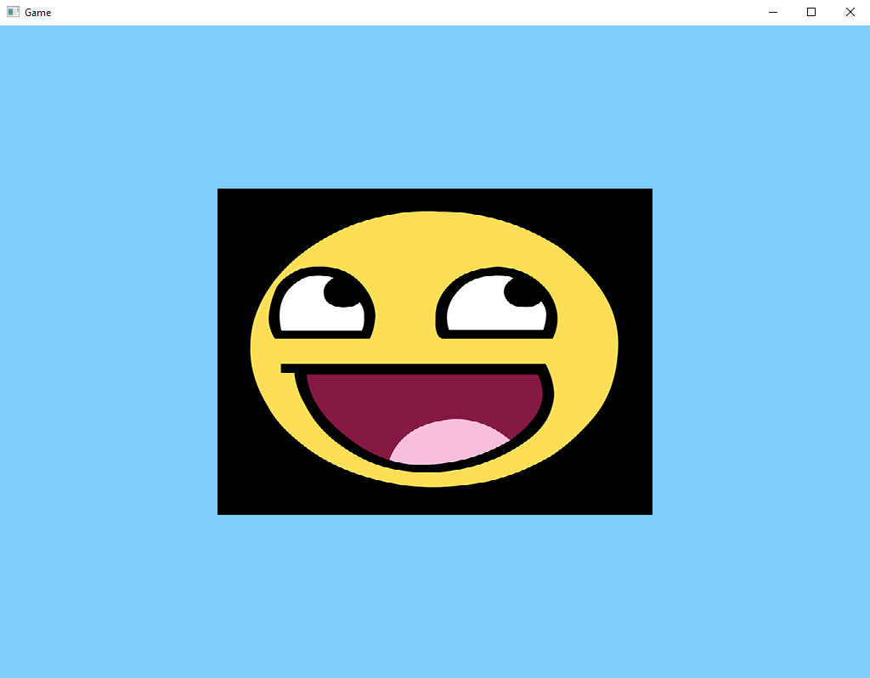

Slide 86
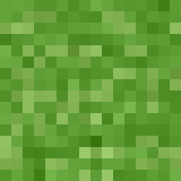

Slide 87
+V
0.0f, 1.0f
1.0f, 1.0f
3
2
0
1
+U
0.0f, 0.0f
1.0f, 0.0f
0.0f, 0.0f
1.0f, 0.0f
1.0f, 1.0f
0.0f, 1.0f

Slide 88
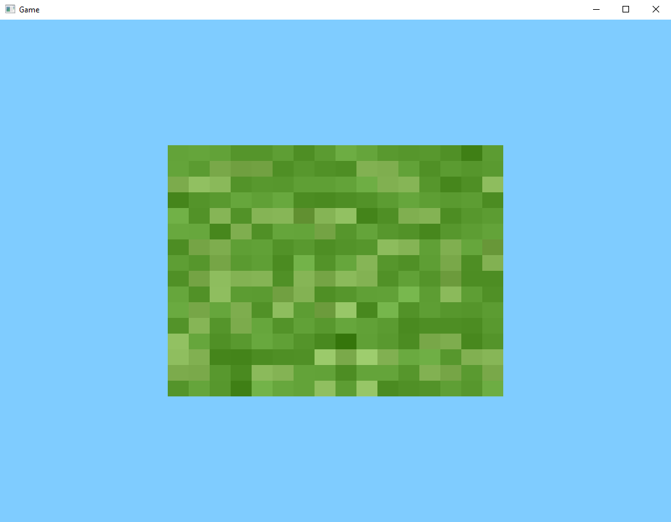

Slide 89
float u0 = 0.0f;
float v0 = 0.0f;
float u1 = 1.0f;
float v1 = 1.0f;
+V
u0, v1
u1, v1
3
2
0
1
+U
u0, v0
u1, v0
u0, v0
u1, v0
u1, v1
u0, v1

Slide 90
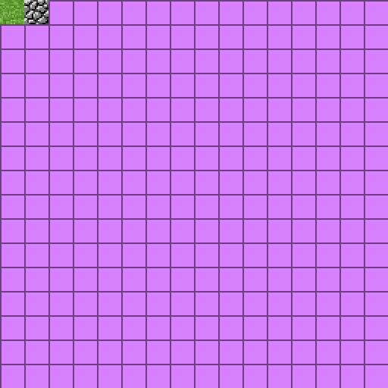

Slide 91
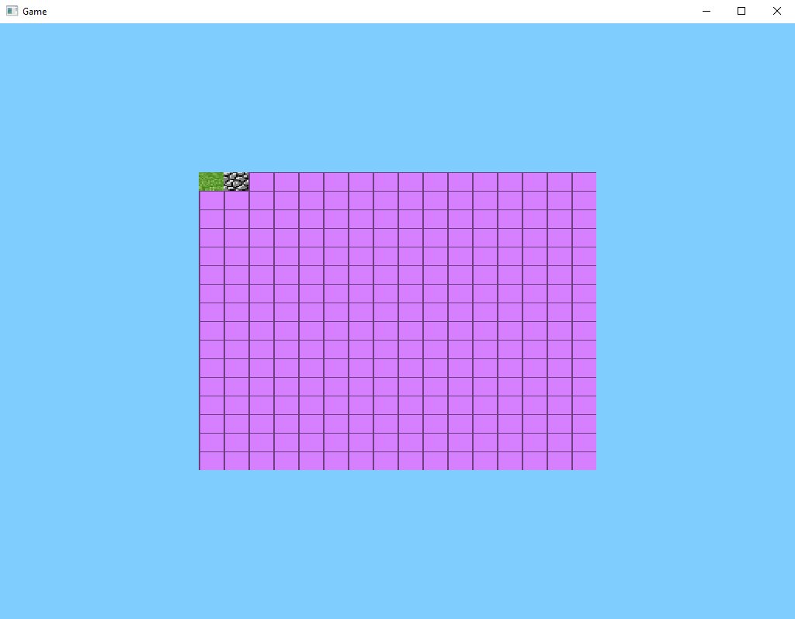

Slide 92
+V
0.0f, 1.0f
3
2
1.0f, 1.0f
0.0f, 0.0f
1.0f, 0.0f
1.0f, 1.0f
0.0f, 1.0f
0.0f, 0.0f
0
1
1.0f, 0.0f
+U

Slide 93
+V
1.0f
0.5f
0.0f
+U

Slide 94
+V
1.0f
0.75f
0.5f
0.25f
0.0f
+U

Slide 95
+V
1.0f
0.9375f
0.875f
0.8125f
0.75f
0.6875f
0.625f
0.5625f
0.5f
0.4375f
0.375f
0.3125f
0.25f
0.1875f
0.125f
0.0625f
0.0f
+U

Slide 96
+V
0.0f, 1.0f
0.0625f, 1.0f
3
2
0
1
0.0f, 0.9375f
0.0625f, 0.9375f
0.0f, 0.9375f
0.0625f, 0.9375f
0.0625f, 1.0f
0.0f, 1.0f
+U

Slide 97

NOTA: Ele pega as texturas de baixo para cima
+V
+V
u0, v1
x1, v1
3
2
int tex = 0;
float u0 = (float)tex / 16.0f;
float v0 = 0.0f;
float u1 = u0 + (1.0f / 16.0f);
float v1 = v0 + (1.0f / 16.0f);
+U
0
1
x0, v0
x1, v0
u0, v0
u1, v0
u1, v1
u0, v1
u0, v1
u1, v1
3
2
+U
0
1
u0, v0
u1, v0

Slide 98
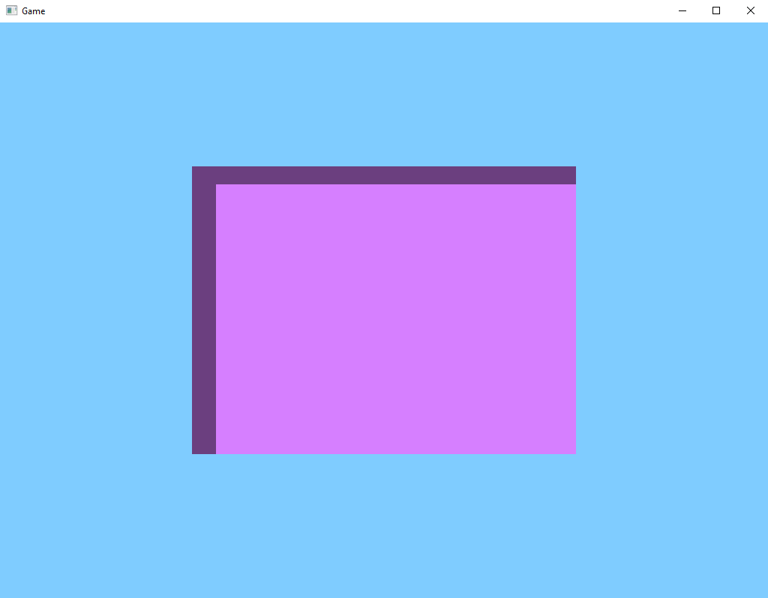

Slide 99
Se removermos essa linha, meio que da certo...
//StbImage.stbi_set_flip_vertically_on_load(1);

Slide 100
NOTA: A textura ficara de ponta cabeça
+V
Textura Correta
+V
u0, v1
x1, v1
int tex = 0;
float u0 = (float)tex / 16.0f;
float v0 = 0.0f;
float u1 = u0 + (1.0f / 16.0f);
float v1 = v0 + (1.0f / 16.0f);
Textura Invertida
3
2
+U
0
1
x0, v0
x1, v0
u0, v0
u1, v0
u1, v1
u0, v1
u0, v1
u1, v1
3
2
+U
0
1
u0, v0
u1, v0

Slide 101
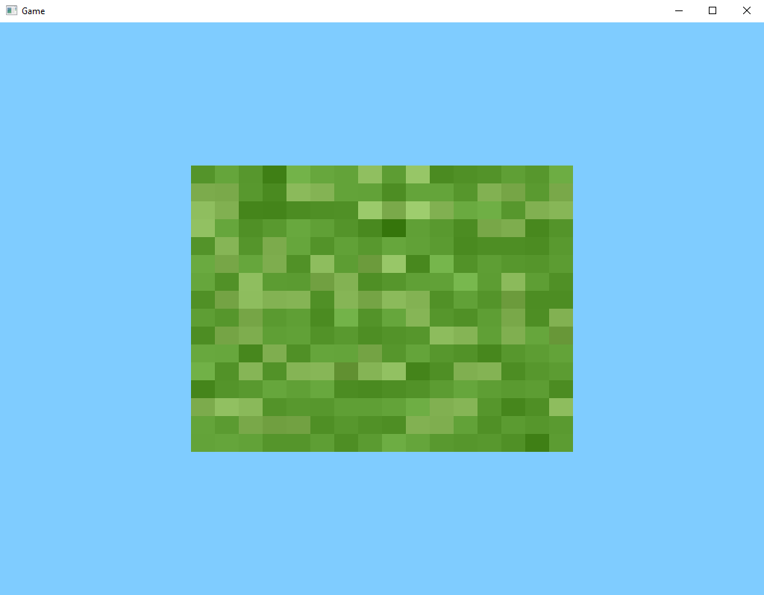

Slide 102
Uma maneira de corrigir é modificando os pontos de coordenadas
+V
+V
u0, v1
x1, v1
0
1
int tex = 0;
float u0 = (float)tex / 16.0f;
float v0 = 0.0f;
float u1 = u0 + (1.0f / 16.0f);
float v1 = v0 + (1.0f / 16.0f);
+U
3
2
x0, v0
x1, v0
u0, v1
u1, v1
u1, v0
u0, v0
u0, v1
u1, v1
0
1
+U
3
2
u0, v0
u1, v0

Slide 104
Outra maneira de corrigir é mantendo essa linha...
StbImage.stbi_set_flip_vertically_on_load(1);

Slide 105
Ele ainda vai pegar as texturas de baixo para cima
+V
+V
u0, v1
x1, v1
3
2
int tex = 0;
float u0 = (float)tex / 16.0f;
float v0 = 0.0f;
float u1 = u0 + (1.0f / 16.0f);
float v1 = v0 + (1.0f / 16.0f);
+U
0
1
x0, v0
x1, v0
u0, v0
u1, v0
u1, v1
u0, v1
u0, v1
u1, v1
3
2
+U
0
1
u0, v0
u1, v0

Slide 106
Então dizendo para ‘v0’ ler de cima para baixo
+V
u0, v1
u1, v1
3
2
0
1
u0, v0
u1, v0
+V
u0, v1
x1, v1
3
2
int tex = 0;
float u0 = (float)tex / 16.0f;
float v0 = (16.0f – 1.0f) / 16.0f;
float u1 = u0 + (1.0f / 16.0f);
float v1 = v0 + (1.0f / 16.0f);
+U
0
1
x0, v0
x1, v0
u0, v0
u1, v0
u1, v1
u0, v1
+U

Slide 107
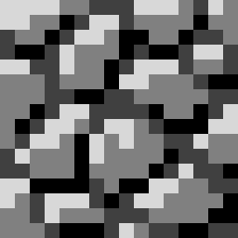
Quando ‘tex’ for igual a 1, teremos a textura da pedra...
+V
u0, v1
u1, v1
3
2
0
1
u0, v0
u1, v0
+V
u0, v1
x1, v1
3
2
int tex = 1;
float u0 = (float)tex / 16.0f;
float v0 = (16.0f – 1.0f) / 16.0f;
float u1 = u0 + (1.0f / 16.0f);
float v1 = v0 + (1.0f / 16.0f);
+U
0
1
x0, v0
x1, v0
u0, v0
u1, v0
u1, v1
u0, v1
+U

Slide 108
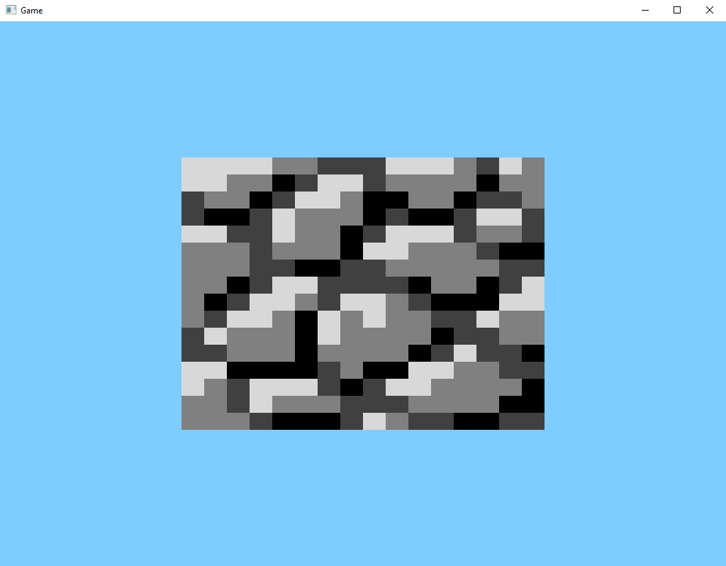

Slide 109
Quando ‘tex’ for igual a 15, teremos a textura do canto superior direito...
+V
u0, v1
u1, v1
3
2
0
1
u0, v0
u1, v0
+V
u0, v1
x1, v1
3
2
int tex = 15;
float u0 = (float)tex / 16.0f;
float v0 = (16.0f – 1.0f) / 16.0f;
float u1 = u0 + (1.0f / 16.0f);
float v1 = v0 + (1.0f / 16.0f);
+U
0
1
x0, v0
x1, v0
u0, v0
u1, v0
u1, v1
u0, v1
+U

Slide 110
Mas quando ‘tex’ for igual a 16, teremos novamente a textura da grama...
+V
u0, v1
u1, v1
3
2
0
1
u0, v0
u1, v0
+V
u0, v1
x1, v1
3
2
int tex = 16;
float u0 = (float)tex / 16.0f;
float v0 = (16.0f – 1.0f) / 16.0f;
float u1 = u0 + (1.0f / 16.0f);
float v1 = v0 + (1.0f / 16.0f);
+U
0
1
x0, v0
x1, v0
u0, v0
u1, v0
u1, v1
u0, v1
+U

Slide 111
tex % 16
tex = 0, retorna 0
tex = 1, retorna 1
tex = 2, retorna 2
tex = 3, retorna 3
tex = 4, retorna 4
tex = 5, retorna 5
tex = 6, retorna 6
tex = 7, retorna 7
tex = 8, retorna 8
tex = 9, retorna 9
tex = 10, retorna 10
tex = 11, retorna 11
tex = 12, retorna 12
tex = 13, retorna 13
tex = 14, retorna 14
tex = 15, retorna 15
tex = 16, retorna 0
tex = 17, retorna 1
tex = 18, retorna 2
tex = 19, retorna 3
tex = 20, retorna 4
tex = 21, retorna 5
tex = 22, retorna 6
tex = 23, retorna 7
tex = 24, retorna 8
tex = 25, retorna 9
tex = 26, retorna 10
tex = 27, retorna 11
tex = 28, retorna 12
tex = 29, retorna 13
tex = 30, retorna 14
tex = 31, retorna 15
tex = 32, retorna 0
tex / 16
tex = 0, retorna 0
tex = 1, retorna 0
tex = 2, retorna 0
tex = 3, retorna 0
tex = 4, retorna 0
tex = 5, retorna 0
tex = 6, retorna 0
tex = 7, retorna 0
tex = 8, retorna 0
tex = 9, retorna 0
tex = 10, retorna 0
tex = 11, retorna 0
tex = 12, retorna 0
tex = 13, retorna 0
tex = 14, retorna 0
tex = 15, retorna 0
tex = 16, retorna 1
tex = 17, retorna 1
tex = 18, retorna 1
tex = 19, retorna 1
tex = 20, retorna 1
tex = 21, retorna 1
tex = 22, retorna 1
tex = 23, retorna 1
tex = 24, retorna 1
tex = 25, retorna 1
tex = 26, retorna 1
tex = 27, retorna 1
tex = 28, retorna 1
tex = 29, retorna 1
tex = 30, retorna 1
tex = 31, retorna 1
tex = 32, retorna 2

Slide 112
Uma das formas de corrigir isto...
+V
u0, v1
u1, v1
3
2
0
1
u0, v0
u1, v0
+V
u0, v1
x1, v1
3
2
int tex = 16;
float u0 = (float)(tex % 16) / 16.0f;
float v0 = ( (16.0f - 1.0f) – (float)(tex / 16) ) / 16.0f;
float u1 = u0 + (1.0f / 16.0f);
float v1 = v0 + (1.0f / 16.0f);
+U
0
1
x0, v0
x1, v0
u0, v0
u1, v0
u1, v1
u0, v1
+U

Slide 113
Ou dessa forma onde você da o numero da linha e da coluna da textura
+V
u0, v1
u1, v1
3
2
0
1
u0, v0
u1, v0
+V
u0, v1
x1, v1
3
2
int texU = 0;
int texV = 1;
float u0 = (float)tex / 16.0f;
float v0 = ((16.0f - 1.0f) - (float)texV) / 16.0f;
float u1 = u0 + (1.0f / 16.0f);
float v1 = v0 + (1.0f / 16.0f);
+U
0
1
x0, v0
x1, v0
u0, v0
u1, v0
u1, v1
u0, v1
+U

Slide 114
Mas não vamos nos preocupar com isso agora

Slide 115
Este é o resultado que queremos obter

Slide 117
6. Projeção

Slide 118
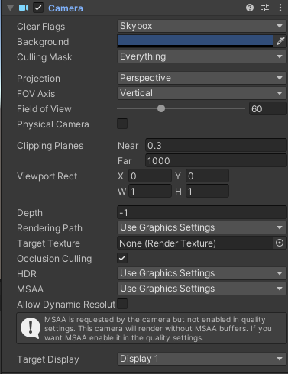

Slide 119
#version 330 core
layout (location = 0) in vec3 aPos;
layout(location = 1) in vec2 aTexCoord;
out vec2 TexCoord;
uniform mat4 projection;
void main() {
gl_Position = projection * vec4(aPos, 1.0);
TexCoord = aTexCoord;
}

Slide 120
public class Shader() {
[...]
public void setMatrix4(string name, Matrix4 matrix) {
GL.UniformMatrix4(GL.GetUniformLocation(this.program, name), false, ref matrix);
}
}

Slide 121
private void matrixProjection() {
Matrix4 projection = Matrix4.Identity;
projection *= CreatePerspectiveFieldOfView();
this.shader.setMatrix4("projection", projection);
}
Private Matrix4 CreatePerspectiveFieldOfView() {
float fovy = MathHelper.DegreesToRadians(60.0f);
float aspect = (float)this.width / (float)this.height;
float depthNear = 0.3f;
float depthFar = 1000.0f;
return Matrix4.CreatePerspectiveFieldOfView(fovy, aspect, depthNear, depthFar);
}

Slide 123
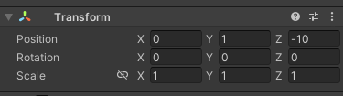

Slide 124
#version 330 core
layout (location = 0) in vec3 aPos;
layout(location = 1) in vec2 aTexCoord;
out vec2 TexCoord;
uniform mat4 projection;
uniform mat4 view;
void main() {
gl_Position = projection * view * vec4(aPos, 1.0);
TexCoord = aTexCoord;
}

Slide 125
private void matrixView() {
Matrix4 view = Matrix4.Identity;
view *= Matrix4.CreateTranslation(new Vector3(0.0f, 0.0f, -10.0f));
this.shader.setMatrix4("view", view);
}

Slide 126
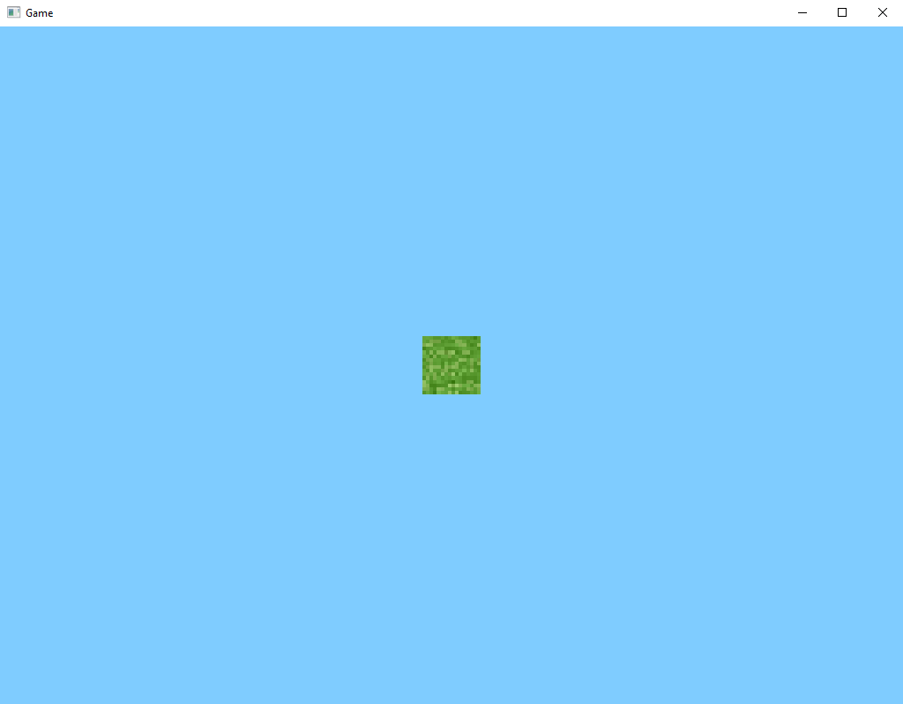

Slide 128
private void matrixProjection() {
Matrix4 projection = Matrix4.Identity;
projection *= CreatePerspectiveOffCenter();
this.shader.setMatrix4("projection", projection);
}
Private Matrix4 CreatePerspectiveOffCenter() {
float left = 0.0f;
float right = (float)this.width;
float bottom = 0.0f;
float top = (float)this.height;
float depthNear = 0.3f;
float depthFar = 1000.0f;
return Matrix4.CreatePerspectiveOffCenter(left, right, bottom, top, depthNear, depthFar);
}

Slide 129
?
?
?
?
?
?

Slide 131
private void matrixProjection() {
Matrix4 projection = Matrix4.Identity;
projection *= CreateOrthographic();
this.shader.setMatrix4("projection", projection);
}
Private Matrix4 CreateOrthographic() {
float width = (float)this.width;
float height = (float)this.height;
float depthNear = 0.3f;
float depthFar = 1000.0f;
return Matrix4.CreateOrthographic(width, height, depthNear, depthFar);
}

Slide 132


Slide 133
protected override void OnRenderFrame(FrameEventArgs args) {
[...]
//GL.ClearColor(0.5f, 0.8f, 1.0f, 0.0f);
[...]
}

Slide 134
#version 330 core
out vec4 FragColor;
uniform bool isWireframe;
in vec2 TexCoord;
uniform sampler2D texture0;
void main() {
if(isWireframe) {
FragColor = vec4(0.0f);
}
else {
//FragColor = texture(texture0, TexCoord);
FragColor = vec4(1.0f);
}
}

Slide 135


Slide 137
+Y
x0, y1
x1, y1
3
2
float x0 = -0.5f * 16.0f;
float y0 = -0.5f * 16.0f;
float x1 = 0.5f * 16.0f;
float y1 = 0.5f * 16.0f;
0
1
+X
x0, y0
x1, y0
x0, y0
x1, y0
x1, y1
x0, y1

Slide 138
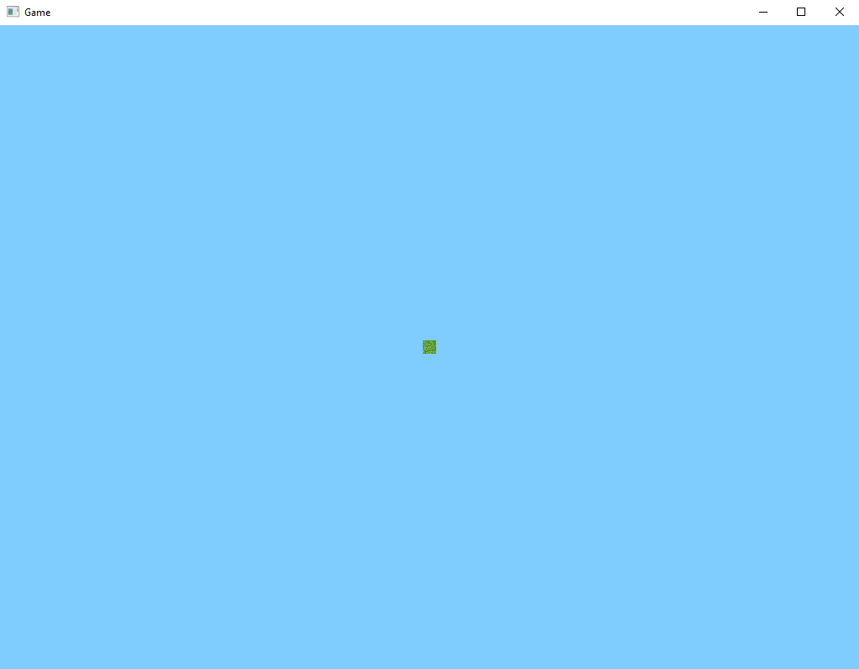

Slide 139
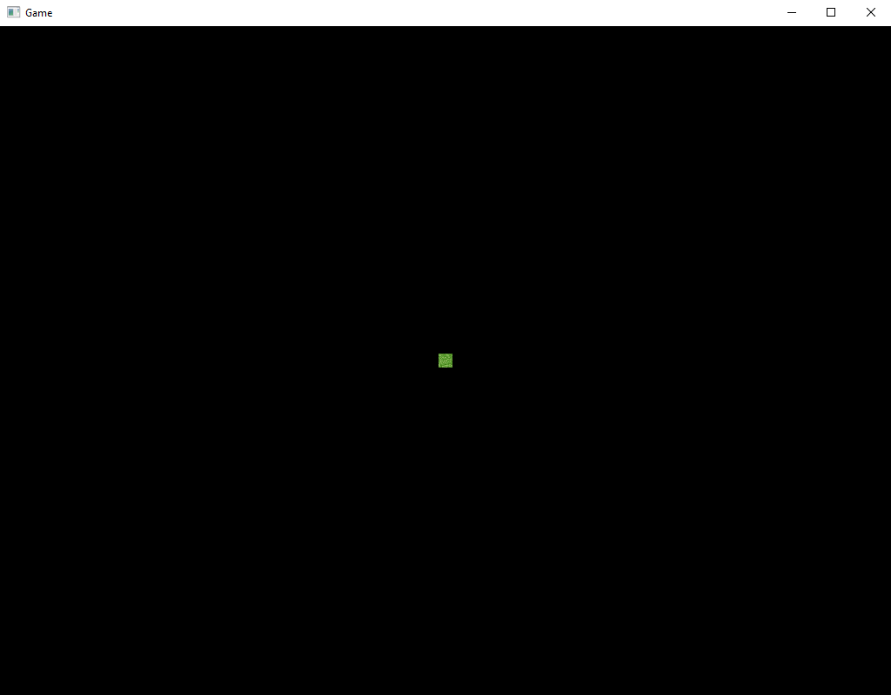

Slide 141
private void matrixProjection() {
Matrix4 projection = Matrix4.Identity;
projection *= CreateOrthographicOffCenter();
this.shader.setMatrix4("projection", projection);
}
Private Matrix4 CreateOrthographicOffCenter() {
float left = 0.0f;
float right = (float)this.width;
float bottom = 0.0f;
float top = (float)this.height;
float depthNear = 0.3f;
float depthFar = 1000.0f;
return Matrix4.CreateOrthographicOffCenter(left, right, bottom, top, depthNear, depthFar);
}

Slide 142
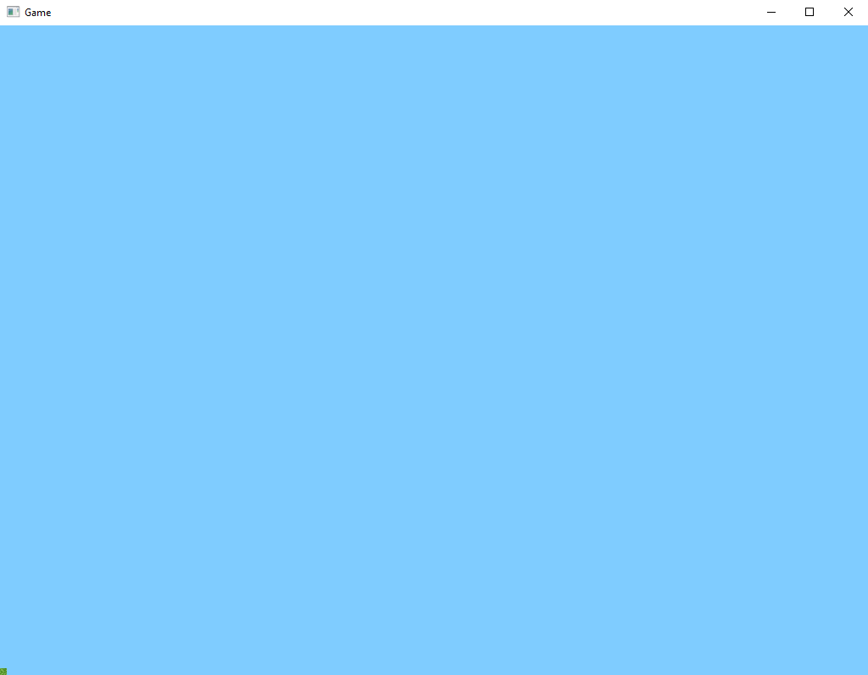

Slide 143
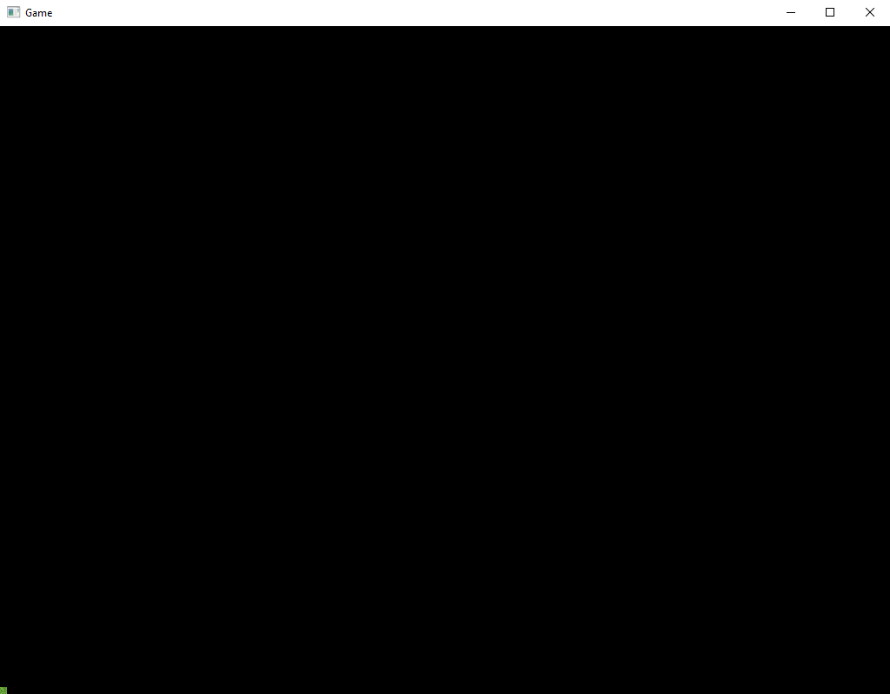

Slide 144
+Y
x0, y1
x1, y1
3
2
float x0 = 0.0f * 16.0f;
float y0 = 0.0f * 16.0f;
float x1 = 1.0f * 16.0f;
float y1 = 1.0f * 16.0f;
0
1
+X
x0, y0
x1, y0
x0, y0
x1, y0
x1, y1
x0, y1

Slide 145
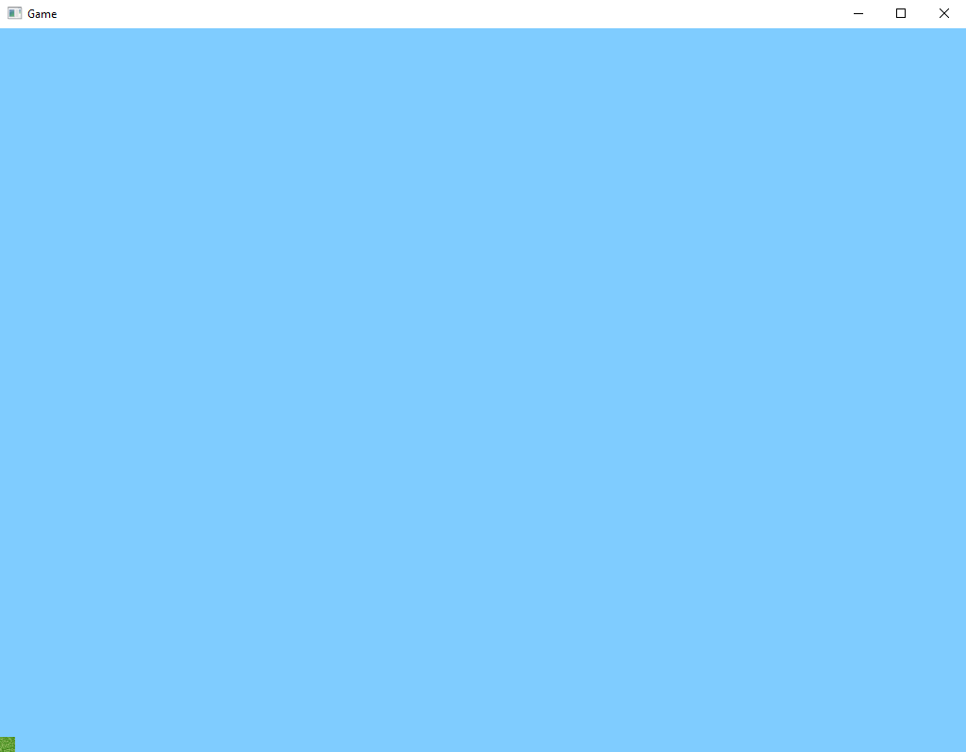

Slide 146
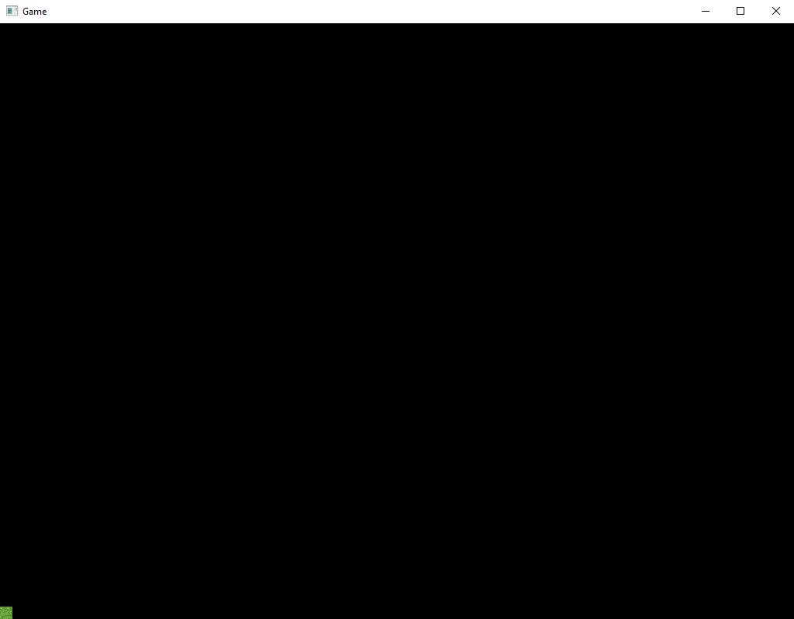

Slide 148
7. Gerando um Bloco

Slide 149
private void matrixView() {
Matrix4 view = Matrix4.Identity;
view *= Matrix4.CreateFromAxisAngle(new Vector3(0.5f, 1.0f, -3.0f), (float)GLFW.GetTime());
view *= Matrix4.CreateTranslation(new Vector3(0.0f, 0.0f, -10.0f));
this.shader.setMatrix4("view", view);
}

Slide 150
+Y
x0, y1
x1, y1
3
2
float x0 = -0.5f;
float y0 = -0.5f;
float x1 = 0.5f;
float y1 = 0.5f;
0
1
+X
x0, y0
x1, y0
x0, y0
x1, y0
x1, y1
x0, y1

Slide 151

+Y
+X
+Z

Slide 152


+Y
+X
+Z

Slide 154
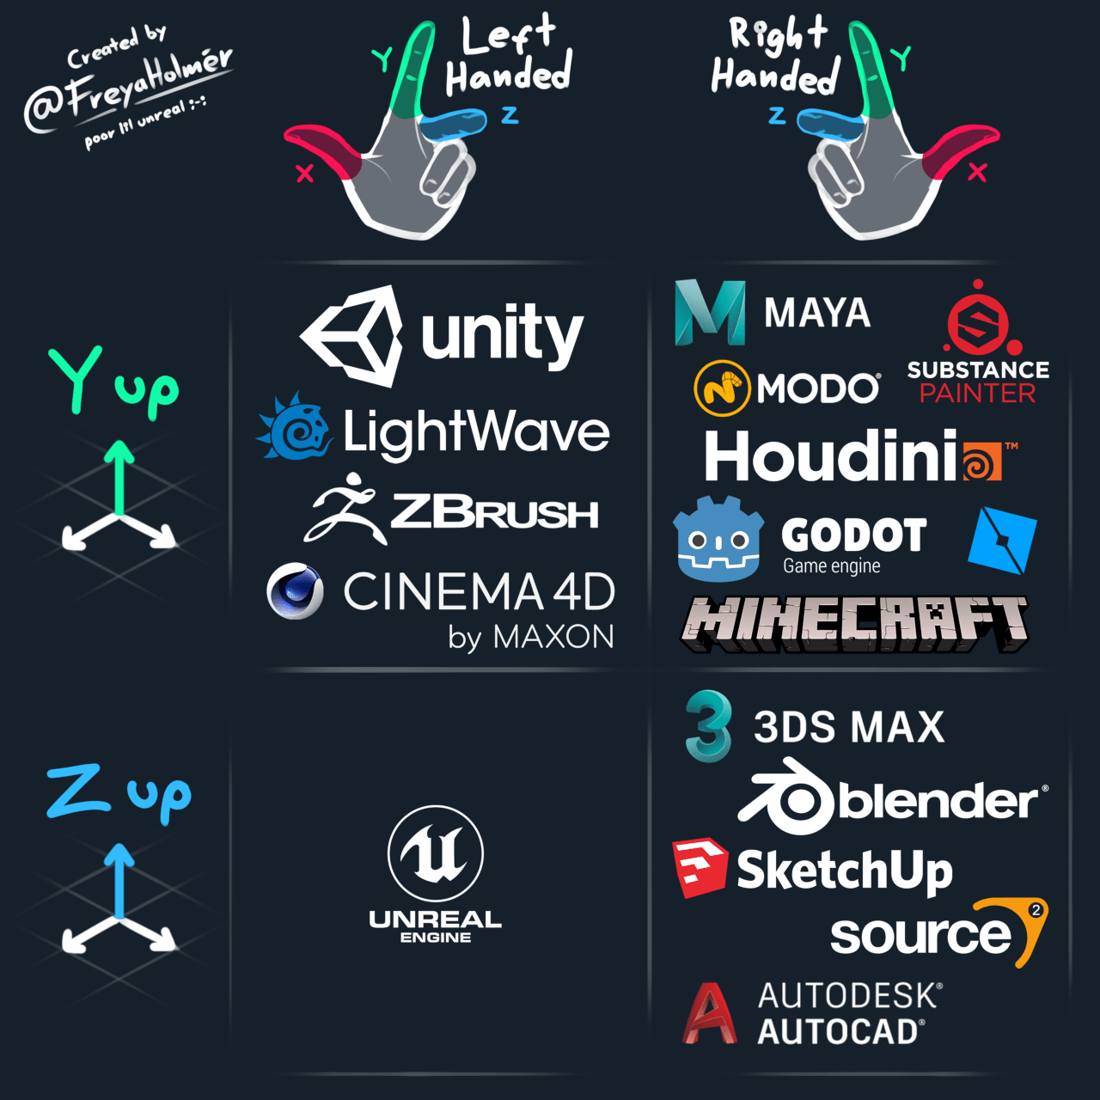

Slide 155

+Y
+X
+Z

Slide 156

+Y
+Z
+X

Slide 157

+Z
+?
+?

Slide 158

+Z
+?
+?

Slide 160
+Y
x1, y1
x0, y1
2
3
float x0 = -0.5f;
float y0 = -0.5f;
float x1 = 0.5f;
float y1 = 0.5f;
+X
1
x0, y0
x1, y0
x1, y1
x0, y1
0
x1, y0
x0, y0
+Z

Slide 161
+Y
x1, y1
x0, y1
2
3
float x0 = -0.5f;
float y0 = -0.5f;
float x1 = 0.5f;
float y1 = 0.5f;
+X
1
x0, y0
x1, y0
x1, y1
x0, y1
0
x1, y0
x0, y0
+Z

Slide 163
private float[] vertexBuffer = new float[300000];
private int[] triangleBuffer = new int[600000];
private float[] texCoordBuffer = new float[200000];
private int vertices = 0;
private float u;
private float v;
private bool hasTexture = false;

Slide 164
private flush() {
[...]
GL.GenBuffers(1, out this.VBO);
GL.BindBuffer(BufferTarget.ArrayBuffer, this.VBO);
GL.BufferData(BufferTarget.ArrayBuffer, this.vertexBuffer.Length * sizeof(float), this.vertexBuffer, BufferUsageHint.StaticDraw);
GL.VertexAttribPointer(0, 3, VertexAttribPointerType.Float, false, 0, 0);
GL.EnableVertexAttribArray(0);
[...]
}

Slide 165
private void vertex(float x, float y, float z) {
vertexBuffer[this.vertices * 3 + 0] = x;
vertexBuffer[this.vertices * 3 + 1] = y;
vertexBuffer[this.vertices * 3 + 2] = z;
if(this.hasTexture) {
this.texCoordBuffer[this.vertices * 2 + 0] = this.u;
this.texCoordBuffer[this.vertices * 2 + 1] = this.v;
}
this.vertices++;
if(this.vertices % 4 == 0) {
int _vertex = this.vertices - 4;
// primeiro Triângulo
this.triangleBuffer[_vertex * 6 + 0] = 0 + _vertex;
this.triangleBuffer[_vertex * 6 + 1] = 1 + _vertex;
this.triangleBuffer[_vertex * 6 + 2] = 2 + _vertex;
// segundo Triângulo
this.triangleBuffer[_vertex * 6 + 3] = 0 + _vertex;
this.triangleBuffer[_vertex * 6 + 4] = 2 + _vertex;
this.triangleBuffer[_vertex * 6 + 5] = 3 + _vertex;
}
}
private void tex(float u, float v) {
this.hasTexture = true;
this.u = u;
this.v = v;
}

Slide 166
+Y
x1, y1, z1
x0, y1, z1
2
3
float x0 = -0.5f;
float y0 = -0.5f;
float z0 = -0.5f;
float x1 = 0.5f;
float y1 = 0.5f;
float z1 = 0.5f;
+X
1
x0, y0, z1
x1, y0, z1
x1, y1, z1
x0, y1, z1
0
x1, y0, z1
x0, y0, z1
+Z

Slide 167
+Y
x1, y1, z0
x0, y1, z0
3
2
float x0 = -0.5f;
float y0 = -0.5f;
float z0 = -0.5f;
float x1 = 0.5f;
float y1 = 0.5f;
float z1 = 0.5f;
0
1
x1, y0, z0
+X
x0, y0, z0
x1, y0, z0
x0, y0, z0
x0, y1, z0
x1, y1, z0
+Z

Slide 168
+Y
x1, y1, z0
x0, y1, z0
2
3
x1, y1, z1
x0, y1, z1
1
0
float x0 = -0.5f;
float y0 = -0.5f;
float z0 = -0.5f;
float x1 = 0.5f;
float y1 = 0.5f;
float z1 = 0.5f;
+X
x0, y1, z1
x1, y1, z1
x1, y1, z0
x0, y1, z0
+Z

Slide 169
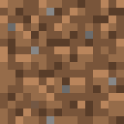
+Y
float x0 = -0.5f;
float y0 = -0.5f;
float z0 = -0.5f;
float x1 = 0.5f;
float y1 = 0.5f;
float z1 = 0.5f;
1
0
x1, y0, z0
+X
x0, y0, z0
2
x0, y0, z0
x1, y0, z0
x1, y0, z1
x0, y0, z1
3
x1, y0, z1
x0, y0, z1
+Z

Slide 170
+Y
x1, y1, z0
2
x1, y1, z1
3
float x0 = -0.5f;
float y0 = -0.5f;
float z0 = -0.5f;
float x1 = 0.5f;
float y1 = 0.5f;
float z1 = 0.5f;
1
x1, y0, z0
+X
0
x1, y0, z1
x1, y0, z0
x1, y1, z0
x1, y1, z1
x1, y0, z1
+Z

Slide 171
+Y
x0, y1, z0
3
x0, y1, z1
2
float x0 = -0.5f;
float y0 = -0.5f;
float z0 = -0.5f;
float x1 = 0.5f;
float y1 = 0.5f;
float z1 = 0.5f;
0
+X
x0, y0, z0
x0, y0, z0
x0, y0, z1
x0, y1, z1
x0, y1, z0
1
x0, y0, z1
+Z

Slide 172
private void matrixView() {
Matrix4 view = Matrix4.Identity;
//view *= Matrix4.CreateFromAxisAngle(new Vector3(0.5f, 1.0f, -3.0f), (float)GLFW.GetTime());
view *= this.LookAt();
view *= Matrix4.CreateTranslation(new Vector3(0.0f, 0.0f, -10.0f));
this.shader.setMatrix4("view", view);
}
Private Matrix4 LookAt() {
// Configura a matriz de visualização isométrica
Vector3 eye = new Vector3(1.0f, 1.0f, 1.0f); // Posição da câmera
Vector3 target = Vector3.Zero; // Onde a câmera está olhando
Vector3 up = Vector3.UnitY; // Direção "para cima" da câmera
return Matrix4.LookAt(eye, target, up);
}

Slide 173
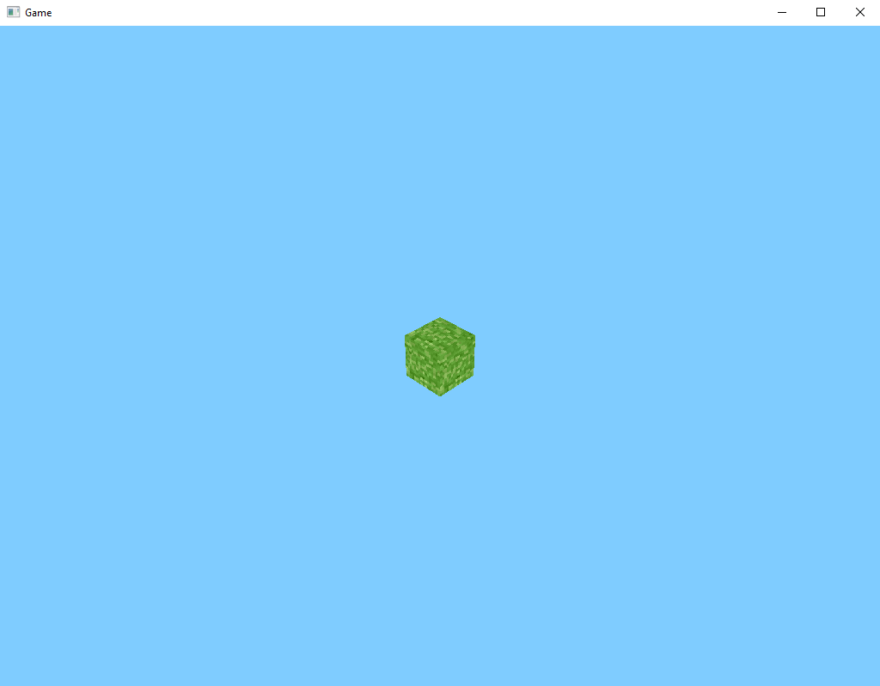

Slide 174
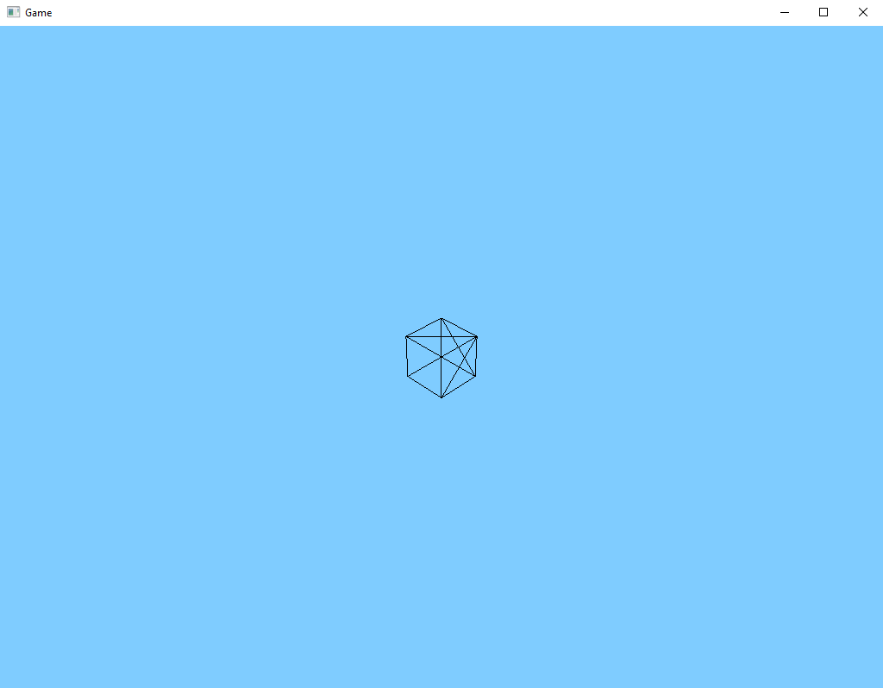

Slide 175
private void openGL_settings() {
GL.Enable(EnableCap.DepthTest);
GL.Enable(EnableCap.CullFace);
GL.CullFace(CullFaceMode.Back);
}

Slide 176
